Slide 1
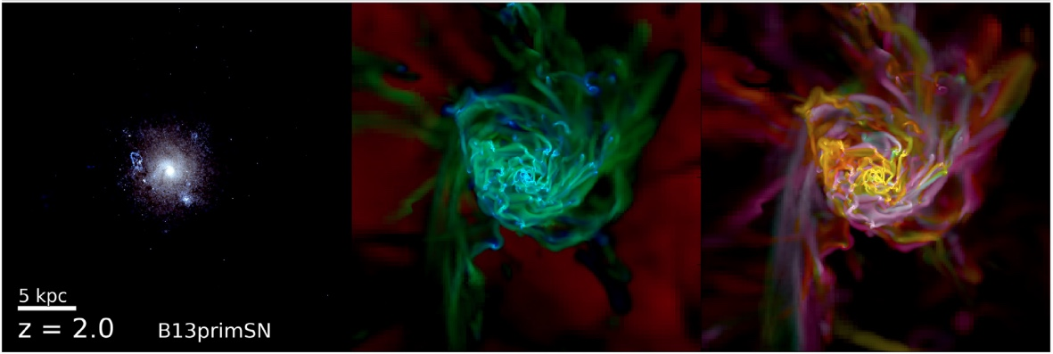
cross-term
injected
primordial

